Slide 1
Rap
The history of rap and hip hop

Slide 2
Where does the word “rap” come from?
According to the Dictionary of Afro-American slang in the 1960s:
“to hold conversation”
“a long impressive monologue”
Before the ’60s:
It referred to a rapping sound (quick, sharp blow)
The talking drum (an ancient and significant element in African-American culture)
Originally referred to as “break-beat music” (percussion break)
“The point wasn’t rapping, it was rhythm. Before there was the ‘word’ there was the ‘beat.’” – Bill Stephney, Public Enemy producer and rap entrepreneur

Slide 3
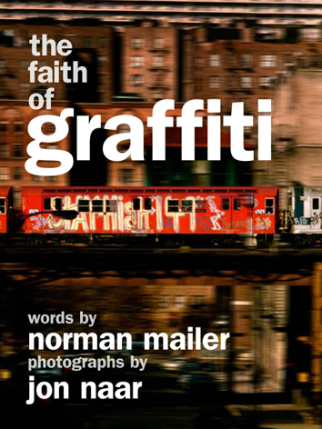
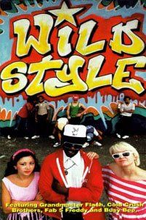
Hip-hop culture encompasses graffiti artists and break-dancers in the mid- to late-’70s, and the media begins to document it in books and films in the early ’80s

Slide 4
Rap, hip hop become mainstream
“Rapper’s Delight” – the Sugar Hill Gang (1979)
First rap record to break into the mainstream, hip hop culture
Went to #36 on the Billboard Pop Chart
The music to which it gave birth had already been evolving in the Bronx for 5 years
Set to the disco hit “Good Times” by Chic.
Breakdancing most successfully crossed over into the media mainstream.
Wild Style! – a docudrama that included the moves of the breakdance pioneers Rock Steady Crew (1983)
The break-beats were a harder sell (they mixed disco and break-beat music)

Slide 5
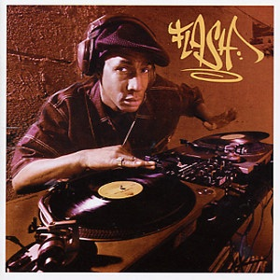
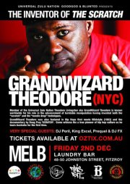
Grandmaster Flash & Grand Wizard Theodore
Recognized by many as hip hop’s most significant contributors
They used two turntables and two copies of the same record to cue up one disk just as the break was ending. Flash rigged up headphones to his turntables for accuracy.

Slide 6
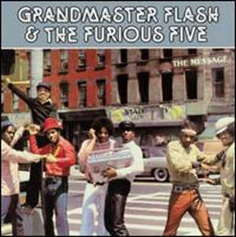
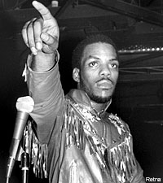
Grandmaster Flash & The Furious Five
“[They] embody the gradual move from underground to overground.” – Rap Attack
Keith “Cowboy” Wiggins
He laid the foundation for the call and response tactics that MCs often use (“Throw your hands in the air,” “Say hey-ooo,” etc.).
He was the first MC to talk about the DJ

Slide 7
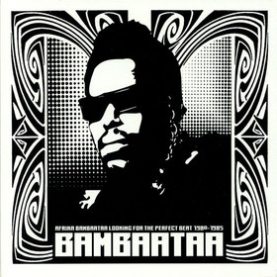
Afrika Bambaataa
Credited with inventing the innovative “break-beat” style
In “Planet Rock,” he introduced the new high-tech-at-the-time style electrofunk
Inspiring “house music” in the ’80s to drum and bass in the ’90s

Slide 8
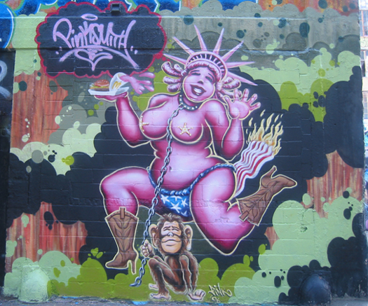
Lady Pink (Sandra Fabara)
Evolved her own graffiti style: using women representations in her work and incorporating political statements
Appeared in Wild Style!

Slide 9
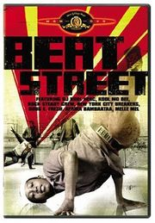
Rap’s roster of women pioneers
“Funk You Up” by Sequence (1979)
“Us Girls Can Boogie Too” by Us Girls
Featured in the 1984 hip-hop film, Beat Street

Slide 10
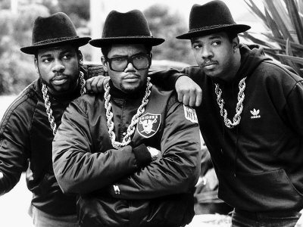
Run-DMC
Darryl “DMC” McDaniels, Joseph “Run” Simmons and Jason “Jam Master Jay” Mizell
The first hip-hop group to be on MTV, earn a Platinum record, be on the cover of Rolling Stone, etc.
They were featured in Krush Groove (1985), a fictionalized re-telling of Joe Run’s older brother, Russell Simmons’, rise as a hip-hop entrepreneur and his struggles to get his label – Def Jam Recordings – off the ground.
http://www.youtube.com/watch?v=BcCaycrPIa0
Teamed with Rick Rubin for their third album, adding a rock element with their lead single, a cover of Aerosmith’s “Walk This Way.”
Notes:
teamed with producer Rick Rubin for their third album. Rubin had just produced LL Cool J's debut album Radio. They later released their third album titled Raising Hell which became the group's most successful album and one of the best-selling rap albums of all-time. The album was certified double-platinum and peaked at number three on the charts.
They were almost done with the album, but Rubin thought that it needed an element that would appeal to rock fans as well. This spurred the lead single "Walk This Way", a cover of the classic hard rock song by Aerosmith.

Slide 11
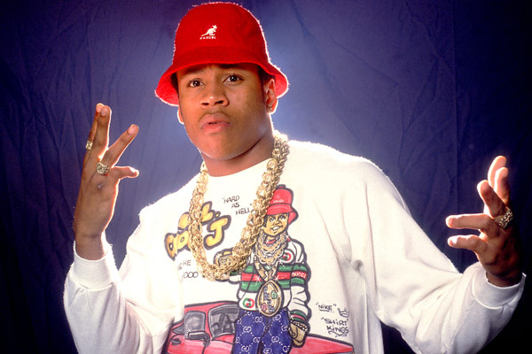
LL Cool J (Ladies Love Cool James)
His impressive verbal skills helped turn the spotlight on the individual rapper as opposed to a crew of MCs
“I Need Love” (1987)
“Mama Said Knock You Out” (1990)

Slide 12
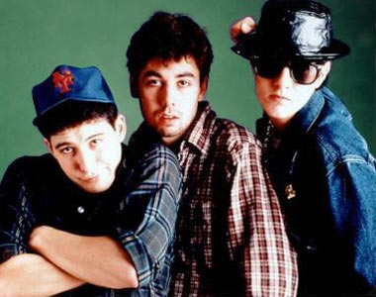
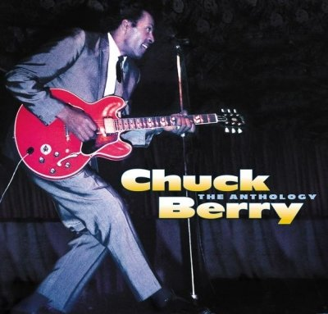
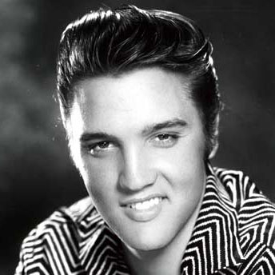
The Beastie Boys
Adam Horovitz (King Adrock), Adam Yauch (MCA) and Michael Diamond (Mike D)
Licensed to Ill and its hit single “You’ve Got to Fight for Your Right to Party” went to number one on their respective sales chart – the first rap records to do so.
Some people were upset, but Adam Yauch was quick to respond: “Rock and roll was started by Chuck Berry, but it’s Elvis who is called the King. So it’s not surprising that it took the Beastie Boys to popularize rap. That’s typical America.”

Slide 13
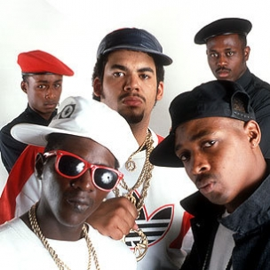
Chuck D, Flavor Flav, Professor Griff and his S1W group (Security of the First World: provided security at hip-hop parties), DJ Lord
Politically, socially-conscious lyrics
“Fight the Power”
Plays a central role in Spike Lee’s Do the Right Thing (1989)
Started as the opening act for the Beastie Boys in 1987, but later helped to usher in the golden age of hip hop
Notes:
Public Enemy started out as opening acts for the Beastie Boys during the latter's Licensed to Ill popularity, and in 1987 released their debut album Yo! Bum Rush The Show
However, over the next few years Public Enemy released It Takes a Nation of Millions to Hold Us Back, Fear of a Black Planet, and Apocalypse 91… The Enemy Strikes Black. In addition to ushering in the golden age of hip hop, during this time, Public Enemy reached the height of their popularity, adulation, and controversy. The group then separated from Def Jam and has since been independently producing, marketing, and publishing their music.
Public Enemy's "Fight the Power" plays a central role in Spike Lee's 1989 film "Do the Right Thing."
Chuck D, Flavor Flav, Professor Griff and his S1W group, DJ Lord (DJ who replaced Terminator X in 1999), and Music Director Khari Wynn

Slide 14
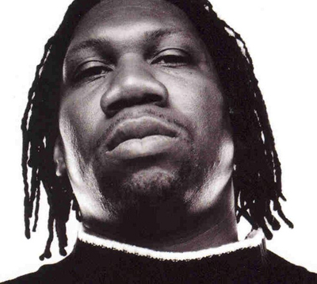
KRS-One (Knowledge Remains Supreme)
KRS-One/Kris Parker lived on the streets of South Bronx from age 13
“9mm” from his album Criminal Minded (1987) helped create the notorious subgenre known as “gangsta rap”
Used brutal imagery to describe the violence and gun culture that was a consequence of the crack epidemic, eventually incorporating political analysis
Influenced by Malcolm X
Socially conscious rap: edutainment (also the title of his fourth album)

Slide 15
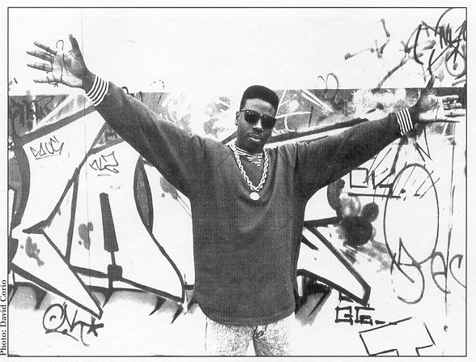
Schoolly-D
Considered by many to create the first true examples of gangsta raps
Rapped about urban violence without the sociopolitical analysis (like KRS-One)
“Gangster Boogie” (1984)
“PSK – What Does it Mean?” (1985)

Slide 16
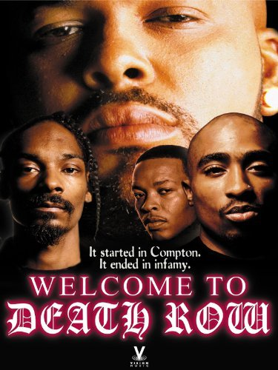
Death Row Records
We’ll watch the documentary Welcome to Death Row which covers:
N.W.A.
Eazy-E
Dr. Dre
Snoop Dogg
Suge Knight
TuPac
Notorious B.I.G.

Slide 17
Source: I Hear America Singing Chapter 6 – Rap: Talking Drum of the Global Village

