Slide 1
History of punk
A power point on punk is kind of hilarious

Slide 2
Punk Music
Fast, loud, raw, and extremely energetic
Simply structured
Meant to be performed live
Lyrics meaningful and often hard to decipher

Slide 3
Subgenres of Punk Music
Hardcore (Black Flag, Bad Brains)
Extremely fast, lyrics often shouted, slam dancing
Oi! (working class, reacting to perception of punkers being rich, artsy college kids)
Straight edge scene (Fugazi, Teen Idols, Minor Threat, etc.) – a counterculture to the counterculture
Thrash/speedcore (influenced by heavy metal)
Art/noise (experimental)
Punkska

Slide 4
U.S. Punk
In the U.S., it was more of a punk scene than a movement
‘70s in New York City
Punk scene didn’t receive much attention until the punk movement in U.K. was given considerable attention

Slide 5
When and where did punk begin?
Very Late 60’s in New York
Officially 1975 in London
One way to think of it: The U.S. created punk, shipped it out to England and they sold it back to us.

Slide 6
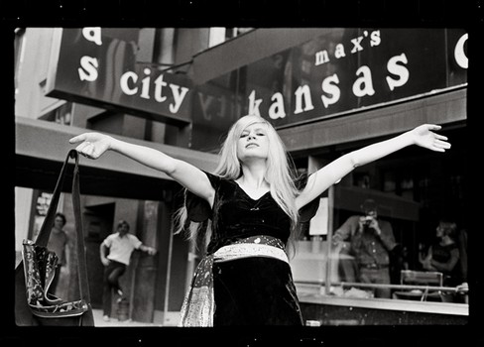
U.S. Punk scene: Max’s Kansas City
A gathering place for artists and musicians from the 1960s to the early 1980s.
Andy Warhol, the Velvet Underground, the New York Dolls, Bruce Springsteen, Bob Marley, Iggy Pop, and Madonna.
Blondie was a waitress there, Lou Reed’s “Walk on the Wild Side” was about the backroom downstairs

Slide 7
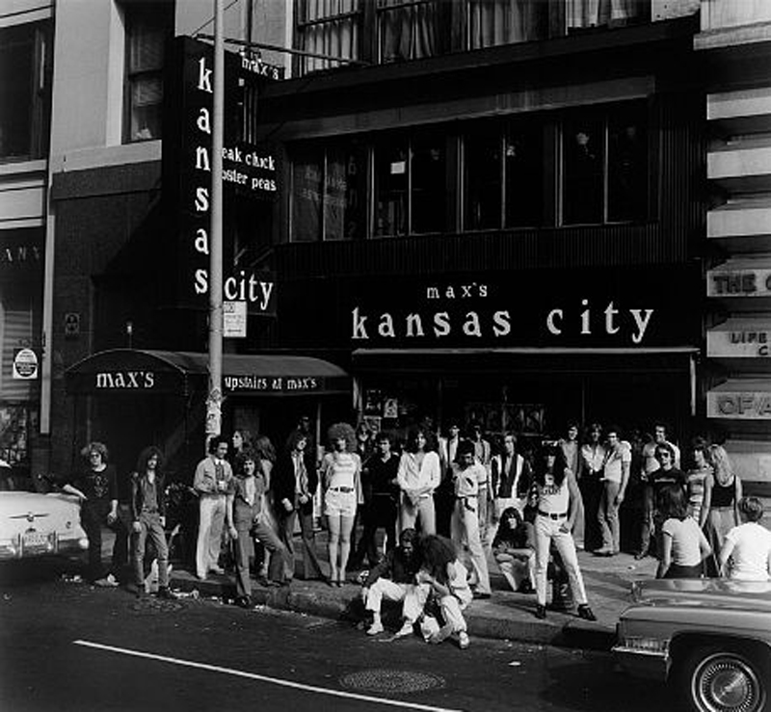

Slide 8
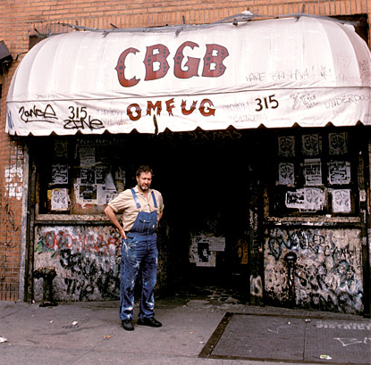
U.S. Punk scene: CBGB’s
CBGB’s (Country Blue Grass Blues)
Originally a run down bar frequented by Hells Angels, but it became the home of US punk in the mid-’70s

Slide 9
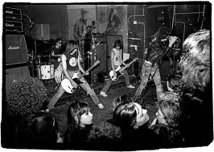
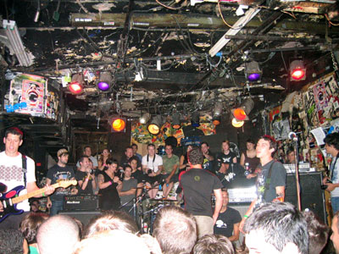
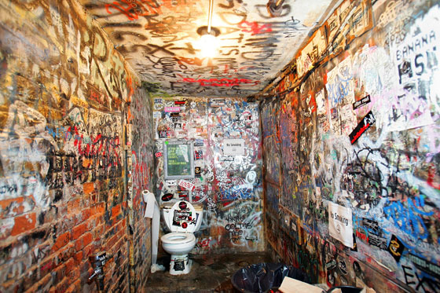

Slide 10
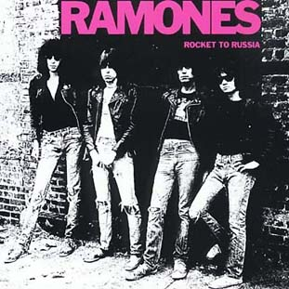
U.S. Punk scene: Artists
“Nothin' to do and no where to go-o-oh I wanna be sedated…”
http://www.youtube.com/watch?feature=player_detailpage&v=Dhh24BB84e4

Slide 11
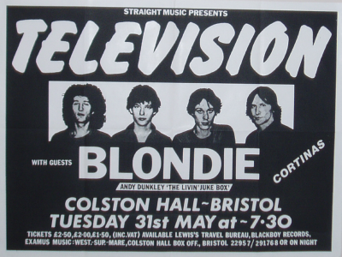
U.S. Punk scene: Artists
“You know all us boys gonna wind up in jail. I don't wanna grow up there's too much contradiction”

Slide 12
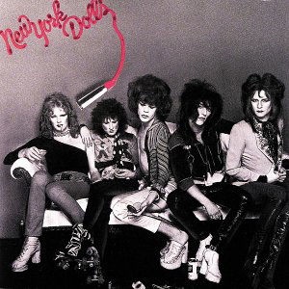
U.S. Punk scene: Artists
Who's got the chaos When you gotta move

Slide 13
U.S. Punk scene: Artists
Everybody's always tryin to tell me what to do Don 't you try to tell me what to do

Slide 14
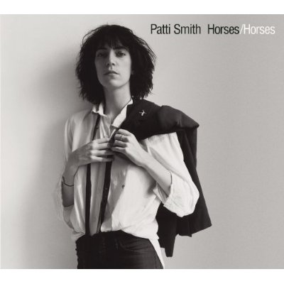
U.S. Punk scene: Artists
Pissing in a river, watching it rise
My bowels are empty, excreting your soul
I'm a slave I'm free

Slide 15
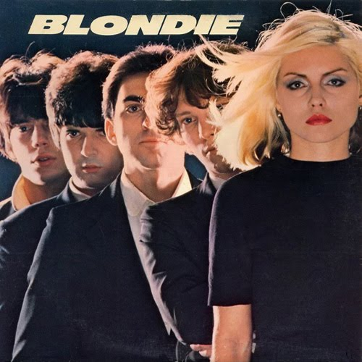
U.S. Punk scene: Artists
I could, but I won't be. You can, but not with me. It's all a mystery. Locked out without a key

Slide 16
Punk in the U.K.
In the U.K., it was more of a punk movement
1975: the punk movement began
In 1975, Britain was suffering from a recession and people were looking for an outlet for their anger. Poor, working class adolescents turned to punk as this outlet.
Jobless = Hopeless = Angry = Punk

Slide 17
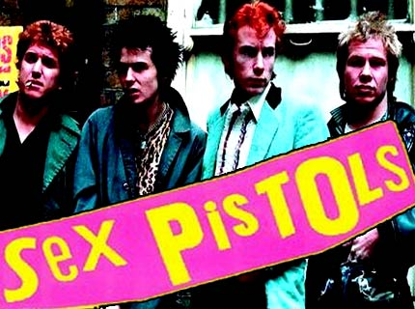
U.K. Punk Movement: Artists
Don't know what I want but I know how to get it I wanna BE anarchy!
Get PISSED DESTROY
http://www.youtube.com/watch?v=C8szRgIcYlY&feature=player_detailpage#t=26s

Slide 18
Punk: More than just music
It has a philosophy based on anarchist, political views and liberation
Many punks believe that the only way to achieve true individual freedom is through abolishing establishments (government, corporations, any sort of conformity or expected ways of living/thinking, etc.)

Slide 19
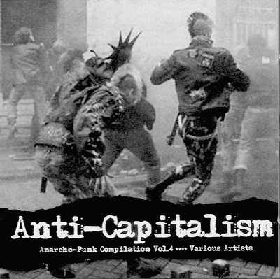
Punk: More than just music
Lyrics are frequently oppositional (anti-romantic, anti-government, anti-parents, anti-peer groups, anti-conformity, etc.)
Punk zines (short for magazines, non-commercial publications, emphasis on DIY)

Slide 20
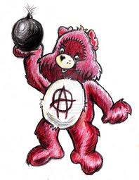

Slide 21
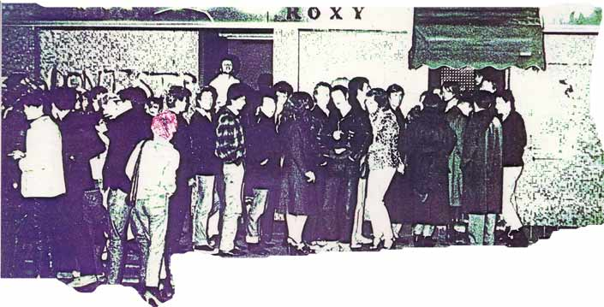
Punk in the U.K.: The Roxy & The Vortex

Slide 22
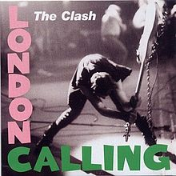
U.K. Punk Movement: Artists
The ice age is coming, the sun's zooming in Meltdown expected…
…but I have no fear 'Cause London is drowning, and I live by the river

Slide 23
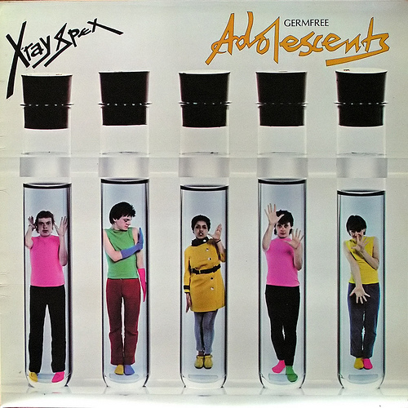
U.K. Punk Movement: Artists

Slide 24
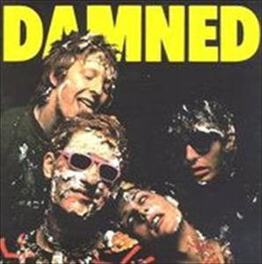
U.K. Punk Movement: Artists

Slide 25
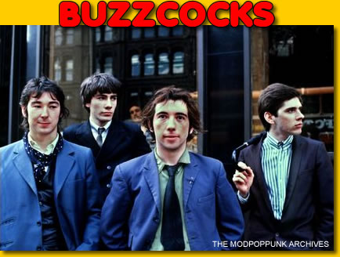
U.K. Punk Movement: Artists

Slide 26
Punk Ethos
ANGRY: Fighting is better than Not Caring (Napoleon complex- most are young, poor, and powerless)
POOR: Working class in style and attitude (if not in actual socio-economic background)

Slide 27
Punk Ethos
HONEST: anti-hypocrisy, anti-bullshit, anti-escapist, happy to rub people's noses in realities they don't wish to acknowledge
SKEPTICAL: especially of authority, romance, business, school, the mass media, promises, and the future

Slide 28
Punk Ethos
SOCIALLY CRITICAL: politically aware, pro-outlaw, anarchistic, anti-military
INDIVIDUALIST: expressive of feelings which polite society would censor out; all you need is “3 chords and the truth”

Slide 29
Punk Ethos
Anti-Establishment
anti-heroic, anti-"rock star" ("Every musician a fan and every fan in a band!");
“We are contemptuous of a majority manipulated by the mass media, unthinking, unaware, sleepwalking through life, conformist, fashion-controlled sheep who are being led to subtle economic slavery and martial slaughter.”

Slide 30
U.K. Artists: Sex Pistols
“The Sex Pistols led the way for many other bands by signing labels with major recording companies.
Paradox of Punk: Can’t be mainstream and also be against mainstream (Cahill 1998: 2).
In 1977 the Sex Pistols broke up and this signified the dying of mainstream punk.

Slide 31
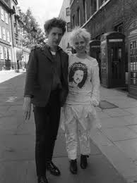
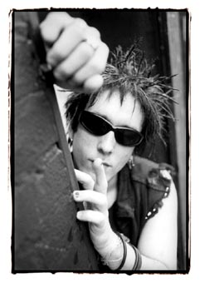
Punk fashion
Malcom McLaren
Richard Hell

Slide 32
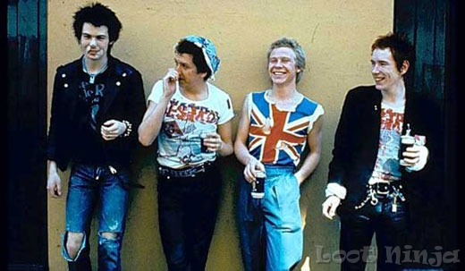
Punk fashion
“Though it seems that punks had little or no fashion sense, they were in a sense so anti-fashion that they made an even bigger statement” (The Pit 1998: 2).

Slide 33
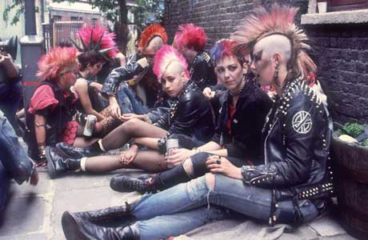
Punk fashion
“…leather jackets, torn and ripped clothes, clothing that in no way matched, and accessories such as safety pins, swastikas, and communist symbols.
…emphasized individualism and embraced anything that stood out from the norm”
(The Pit 1998: 2).

Slide 34
Is it Punk?
Lyrically?
Anti-establishment?
Socially Critical?
Skeptical/Honest?
Angry?
Individualistic?
Musically?
Simply structured?
Fast, loud, raw, and extremely energetic?
http://www.youtube.com/watch?v=kXbvUrbCfJE&feature=player_detailpage
http://www.youtube.com/watch?v=QeWBS0JBNzQ&feature=player_detailpage#t=37s
http://www.youtube.com/watch?v=oKsxPW6i3pM&feature=player_detailpage#t=51s
http://www.youtube.com/watch?v=q27BfBkRHbs&feature=player_detailpage
http://www.youtube.com/watch?v=cKns87v96qs&feature=player_detailpage#t=92s
http://www.youtube.com/watch?v=MSFzcKE08r4&feature=player_detailpage

